Slide 1
Genetic Privacy in the Era of Personal Genomics
Xinghua Mindy Shi
x.shi@uncc.edu
http://shilab.uncc.edu
Department of Bioinformatics and Genomics
University of North Carolina at Charlotte
November 27, 2018

Slide 2
Outline
A brief introduction to human genetics and personal genomics
Infringement of genetic privacy
Protection of genetic privacy
Guidelines, rules and laws
Genetic hiding and de-identification
Open access based on agreement
Controlled access model
Data privacy protection
Cryptographic solutions
Summary and future work

Slide 3
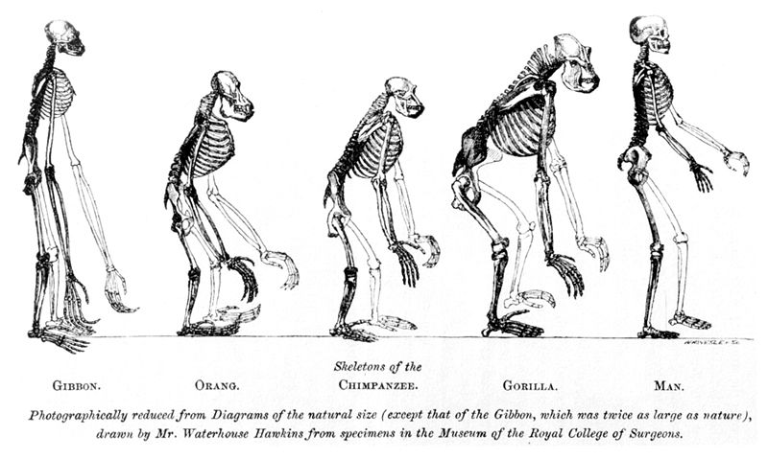
Human’s Place in Nature

Slide 4
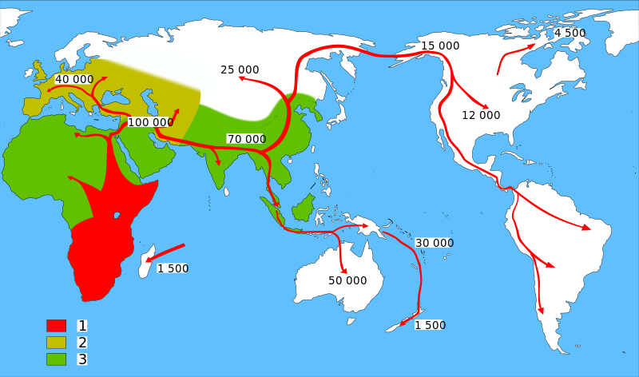
Map of early human Migrations “Out-of-Africa”
Homo sapiens (model humans)
Neanderthals (extinct human)
Early Hominids (early humans)
http://en.wikipedia.org/wiki/Recent_African_origin_of_modern_humans

Slide 5
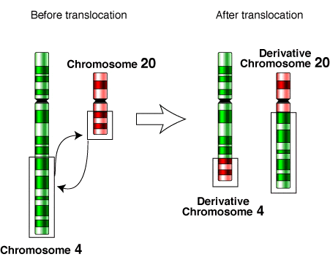
Genetic Variants
Ref.
A
Sample
C
Single Nucleotide Polymorphisms (SNPs, over a hundred million, ~0.1% genetic difference)
1bp
Small Insertions and Deletions (INDELs, tens of millions, ~0.2-0.3%)
Multiple base pairs (1bp ~ 50bp, arbitrary)
Structural Variants (SVs, ~100 thousand, ~0.6-0.7% genetic difference)
A large number of base pairs (50bp+, arbitrary)
Encompasses:
Copy number variants (CNVs: Deletions, Duplications, Insertions)
Balanced events (Inversions, Translocations)
Ref.
A
Sample
TCA
Deletion
Duplication
Insertion
Inversion
Ref.
Ref.
Ref.
Ref.
Sample
Sample
Sample
Sample

Slide 6

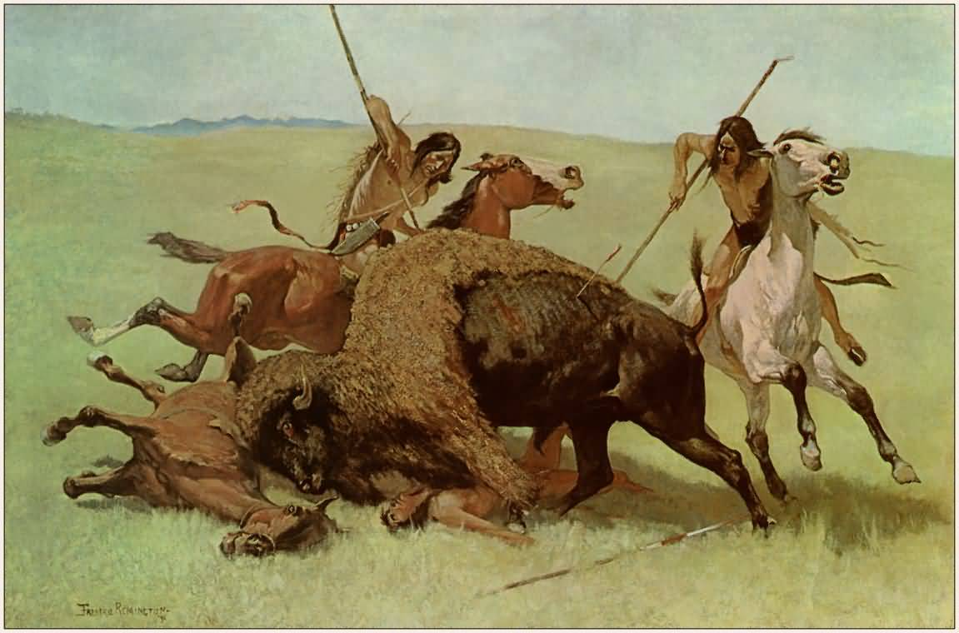
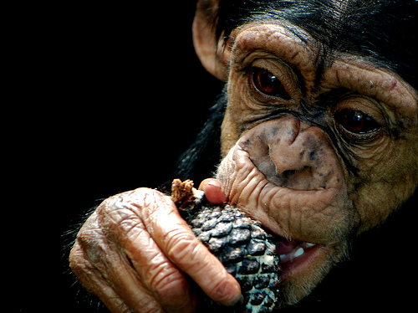
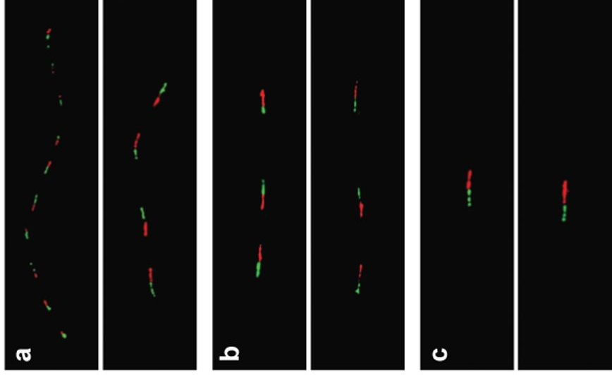

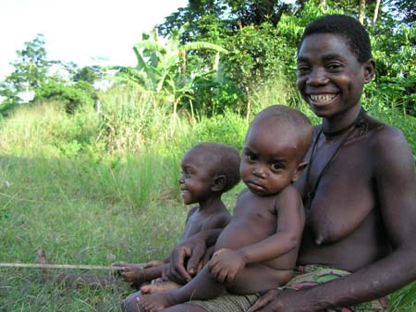
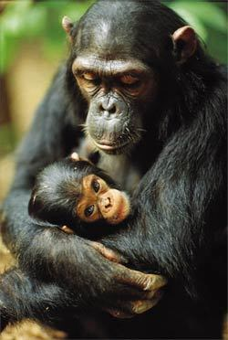
Salivary amylase gene
Salivary amylase gene Amy1: More copy numbers in populations with high-starch diets.
Japanese
Biaka (Africa)
Chimpanzee
Perry GH et al. Nature Genetics 2007

Slide 7
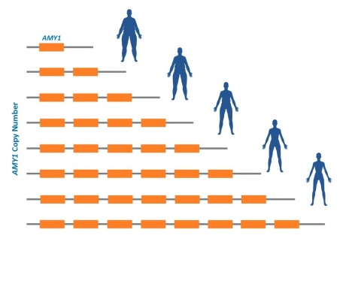
AMY1 and Obesity
Individuals with more copies of AMY1 were at lower risk of obesity.
The chance of being obese for people with <4 copies of the AMY1 gene was approximately 8 times higher than in those with more than 9 copies of this gene.
The researchers estimated that with every additional copy of the salivary amylase gene there was approximately a 20% decrease in the odds of becoming obese.
Falchi M et al. Nature Genetics 2014

Slide 8
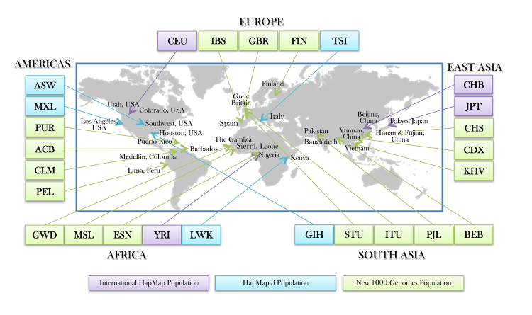
The 1000 Genomes Project
26 populations, 2504 individuals.
1000 Genomes Project Consortium.

Slide 9
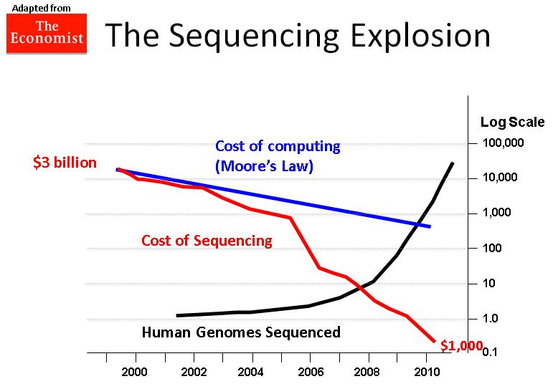

Slide 10
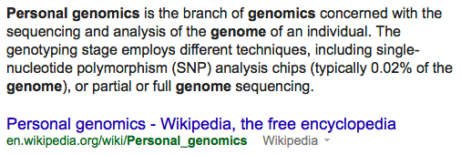
Personal Genomics

Slide 11
Clinical Sequencing – Federal Initiatives
Million Genome Project from Obama’s Precision Medicine Initiative, 2015.
Genomes England Project (the 100,000 Genomes Project) 2014, UK 10K Project.
Million Veterans Project US, already collected DNA samples from 343,000 former soldiers 2015.
International Cancer Genome Consortium (ICCG) and The Cancer Genome Atlas (TCGA) projects chart the genomic changes involved in more than 20 types of cancer (WGS of 5000 individuals, WES of 10,000 individuals).

Slide 12
Clinical Sequencing – Private Sections
J. Craig Venter plans to sequence one million genomes by 2020 using private funding.
One of the world’s largest private bio-banks, 23andMe, collected 800,000 spit samples.
Large disease consortia and hospitals/institutions/pharmaceutical/biotech companies conduct whole genome sequencing of clinical samples.
Notes:
Google Genomics
Facebook?

Slide 13
From Genomics to Metagenomics
Microbes thrive on us: we provide wonderfully rich and varied homes for our 100 trillion microbial (bacterial and archaeal) partners.
Human Microbiome Project
characterize microbial communities found at multiple human body sites and to look for correlations between changes in the microbiome and human health.
We are also host to countless viruses. A recent survey reported that human feces contain about a billion RNA viruses per gram, representing 42 viral “species”.
Viral Metagenomics
National Research Council (US) Committee on Metagenomics: Challenges and Functional Applications. 2007

Slide 14
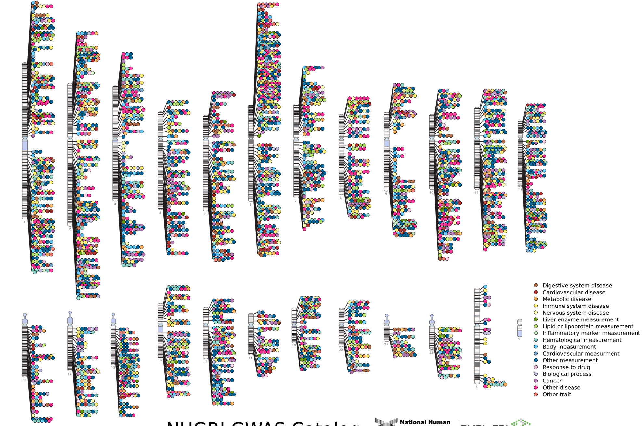

Published Genome-Wide Associations through 12/2013
Published GWA at p≤5X10⁻⁸ for 17 trait categories
NHGRI GWA Catalog
www.genome.gov/GWAStudies
www.ebi.ac.uk/fgpt/gwas/
Notes:
chromosome ideogram

Slide 15
NHGRI GWA Catalog
www.genome.gov/GWAStudies
www.ebi.ac.uk/fgpt/gwas/

Slide 16
Conveying Genetic Findings
Genetic counseling as an integral part of clinical process
The NHLBI 2010 working group concluded that individual genetic results should (with conditions) be offered to study participants in a timely manner if they meet all of the following criteria (recommendation 1):
The genetic finding has important health implications for the participant and the associated risks are established and substantial.
The genetic finding is actionable; that is, there are established therapeutic or preventive interventions or other available actions that have the potential to change the clinical course of the disease.
The test is analytically valid and complies with all applicable laws.
During the informed consent process or subsequently, the study participant has opted to receive his/her individual genetic results.

Slide 17
Ethical Issues about Incidental Findings
When investigators obtain genetic data from research participants, they may incur an ethical responsibility to inform at-risk individuals about clinically significant variations discovered during the course of their research.
Perhaps the largest obstacle to reviewing and communicating incidental findings in genomics research is the sheer magnitude of the task (tens of millions of genetic variants).

Slide 18
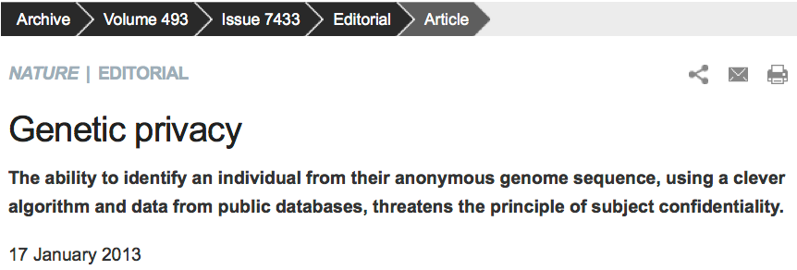
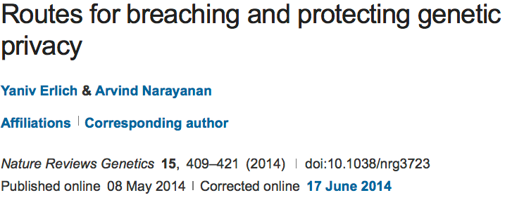
Genetic Privacy

Slide 19
Infringement of Genetic Privacy
Identity attack
Personal identifiable information
Trait attack
Trait information associated with genomic information (e.g. genotypes/sequences)

Slide 20
Protection of Genetic Privacy
Guidelines, rules and laws
Genetic hiding and de-identification
Open access based on agreement
Controlled access model
Data privacy protection
Cryptographic solutions
Notes:
A concession or concession agreement

Slide 21
Ethics and HIPAA Review
Key to advancing genetics diagnosis research
Private personal health information can be protected
Discrimination/Bias based on released heath information can be eliminated (minimized)

Slide 22
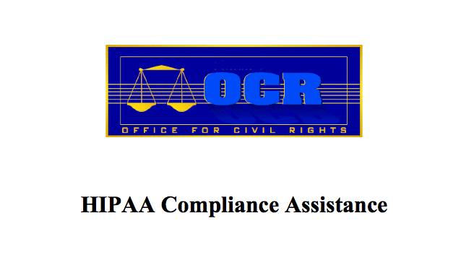
HIPAA Privacy Rule
All federal grants with human subjects involved should be protected by HIPAA

Slide 23
Introduction to HIPAA
The Standards for Privacy of Individually Identifiable Health Information (“Privacy Rule”) establishes, for the first time, a set of national standards for the protection of certain health information.
The U.S. Department of Health and Human Services (“HHS”) issued the Privacy Rule to implement the requirement of the Health Insurance Portability and Accountability Act of 1996 (“HIPAA”).
The Privacy Rule standards address the use and disclosure of individuals’ health information - called “protected health information” by organizations subject to the Privacy Rule - called “covered entities,” as well as standards for individuals' privacy rights to understand and control how their health information is used.
Within HHS, the Office for Civil Rights (“OCR”) has responsibility for implementing and enforcing the Privacy Rule with respect to voluntary compliance activities and civil money penalties.

Slide 24
Information Protected by HIPAA
Protected Health Information
The Privacy Rule protects all "individually identifiable health information"
De-Identified Health Information
There are no restrictions on the use or disclosure of de-identified health information.

Slide 25
HIPAA Safe Harbor Rule
Dissemination of demographic identifiers has been the subject of tight regulation in the US health care system.
The maximal resolution of any date field, such as hospital admission dates, is in years.
The maximal resolution of a geographical subdivision is the first three digits of a zip code (for zip code areas with populations of >20,000).

Slide 26
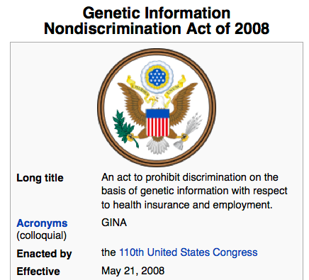
GINA

Slide 27
Protection of Genetic Privacy
Guidelines, rules and laws
Genetic hiding and de-identification
Open access based on agreement
Controlled access model
Data privacy protection
Cryptographic solutions

Slide 28
Genetic hiding/masking
The public release of Dr James Watson’s genome sequence was removed of all gene information about apolipoprotein E (ApoE). This decision was rooted from respecting Dr Watson’s wishes for preventing prediction of his risk for late-onset Alzheimer’s disease conveyed by APOE risk alleles.
However, the linkage disequilibrium (LD, i.e., non-random associations) between other polymorphisms and APOE can be used to predict APOE status using advanced computational methods.
Therefore, it is insufficient to hide genetic information at disease risk loci by simply removing the genotypes or sequences at these loci.
Nyholt DR, Yu C, and Visscher PM. On Jim Watson’s APOE status: genetic information is
hard to hide. Eur J Hum Genet., 17(2):147149, 2008.
Notes:
shared population histories

Slide 29
De-identification is insufficient…
De-identified genomic data are typically published with additional metadata such as basic demographic details, inclusion and exclusion criteria, pedigree structure and health conditions that are crucial to the study.
Nonetheless, these pieces of metadata can be exploited to trace the identity of unknown genomes. For example, the combination of data of birth, gender and five-digit zip code can uniquely identify 87% of US individuals.
There are extensive public resources such as voter registries, public record search engines and social media that link demographic quasi-identifiers to individuals.
Erlich Y, Narayanan A. Routes for breaching and protecting genetic privacy. Nat Rev Genet. 2014 Jun;15(6):409-21.
L. Sweeney, Simple Demographics Often Identify People Uniquely. Carnegie
Mellon University, Data Privacy Working Paper 3. Pittsburgh 2000.

Slide 30
Infringement of genetic privacy when multiple data types are combined
Use the 1000 Genomes Project Phase 1 data with whole genome sequences of 1,092 individuals (no phenotypes so publicly accessible)
Surnames can be recovered from personal genomes by profiling short tandem repeats on the Y chromosome (Y-STRs) and querying recreational genetic genealogy databases.
A combination of a surname with other types of metadata, such as age and state, can be used to triangulate the identity of the target.
Age information is taken out from the publicly accessible 1000 Genomes Project data.
Gymrek M, et al. Science, 2013

Slide 31
Identifying genetic relatives without compromising privacy
Define a ‘‘genome sketch’’ (GS) to represent an individual’s segments that allows us to compute the number of segment matches between a pair of individuals without revealing the full genetic information of an individual.
Address the privacy issue of GSs by using a relatively new cryptographic construct called a ‘‘secure GS’’ related to the theory of error-correcting codes. A secure GS is a construct that allows for the computation of a set distance between two sketches only if their distance is within a certain threshold.
Applications: Identification of parent–child relationships in the HapMap data; Identification of second-order genetic relationships in the 1000 Genomes data set; Identification of more distant relatives in simulated data.
He D, et al. Genome Research, 2014
Notes:
Eleazar Eskin

Slide 32
Protection of Genetic Privacy
Guidelines, rules and laws
Genetic hiding and de-identification
Open access based on agreement
Controlled access model
Data privacy protection
Cryptographic solutions

Slide 33
Personal Genome Project
Sharing data is critical to scientific progress, but has been hampered by traditional research practices.
The Personal Genome Project was founded in 2005 and is dedicated to creating public genome, health, and trait data: invite willing participants to publicly share their personal data for the greater good.

Slide 34
PGP Accident
Another accident of personal privacy is the recent exposure of the full names of PGP participants from filenames in the database.
The PGP, an open repository of human genomes and all related traits, allowed participants to upload 23andMe genotyping files to the participants’ public profile webpages. Many users simply used the default name convention which is the first and last names of the user, and thus made their genotypes explicitly identifiable.

Slide 35
Global Alliance (GA4GH)
The Global Alliance for Genomics and Health (Global Alliance) is an international coalition, dedicated to improving human health by maximizing the potential of genomic medicine through effective and responsible data sharing.
Since its formation in 2013, the Global Alliance for Genomics and Health is leading the way to enable genomic and clinical data sharing. The Alliance’s Working Groups are producing high-impact deliverables to ensure such responsible sharing is possible, such as developing a Framework for Data Sharing to guide governance and research and a Genomics API to allow for the interoperable exchange of data. The Working Groups are also catalyzing key collaborative projects that aim to share real-world data, such as Matchmaker Exchange, Beacon Project, and BRCA Challenge.
http://genomicsandhealth.org/

Slide 36
Protection of Genetic Privacy
Guidelines, rules and laws
Genetic hiding and de-identification
Open access based on agreement
Controlled access model
Data privacy protection
Cryptographic solutions

Slide 37
Homer’s Attack
GWAS statistics do not completely conceal identity because they can be used to assess the probability of a person belonging to a case or test group based on his genotypes at a number of markers.
Suggest that composite statistics across cohorts, such as allele frequency or genotype counts, do not mask identity within genome-wide association studies.
Genetic privacy can be breached even if only aggregate data is accessible.
The genotype-phenotype data (dbGaP) at NIH/EBI is controlled access.
Homer N, et al. Plos Genetics, 2008

Slide 38
Extension of Homer’s Attack
Follow-up studies have reported that the statistics can be utilized for privacy disclosure can be less stringent for GWAS participants.
For example, Want et al. (ACM-CCS 2009) extended Homer’s attack by utilizing a more powerful statistics (r2) which captures the LD between pairwise SNPs, rather than the allele frequencies in Homer’s attack.

Slide 39
Our Proposed Attacks
Our recent work has further shown that summary statistics in public GWAS catalog can be mined to introduce attacks on personal traits and identities of not only GWAS participants, but also regular individuals (who are not participants of GWAS).

Slide 40
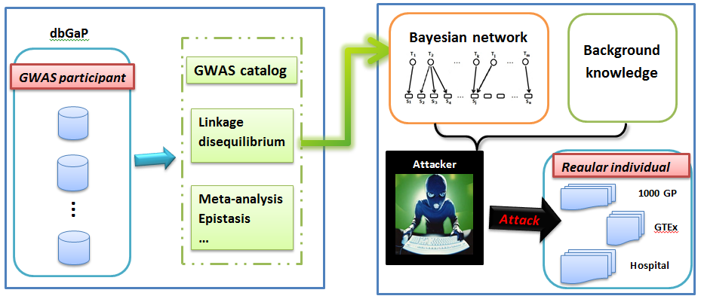
Infringement of Genetic Privacy
“Using Aggregate Human Genome Data for Individual Identification”, Wang Y, Wu X, and Shi X, BIBM13
(Best Paper Award).

Slide 41
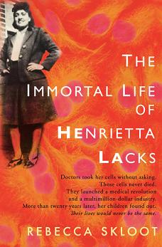
Genetic Privacy of HeLa Cells
A recent release of the whole genome sequence of HeLa cells, one of the most widely used yet controversial cell lines, has motivated significant debate on the privacy concern of Henrietta Lacks (the source of Hela cells) and her descendents from open access of her sequence.
Due to the privacy concern brought by the general public and scientific communities, the original publication was retracted and the sequence of HeLa cells was taken out from public domain.
The HeLa sequence is now under controlled access from dbGaP and the applications for access has to be reviewed by a committee composed of scientists and Lacks family members.

Slide 42
Other Genomics Data
Although genotype data is under controlled access such as in dbGaP, gene expression profiles and known statistics are usually open and unprotected.
A recent study reported that these expression data could be used to predict the individuals’ genotypes at particular loci.
Hence, the openly accessed gene expression and RNA sequencing data provides yet another potential source of privacy disclosure.
Eric E Schadt, Sangsoon Woo, and Ke Hao. Bayesian method to predict individual snp genotypes
from gene expression data. Nature genetics, 44(5):603–608, 2012.
Notes:
epigenomics

Slide 43
Protection of Genetic Privacy
Guidelines, rules and laws
Genetic hiding and de-identification
Open access based on agreement
Controlled access model
Data privacy preservation
Cryptographic solutions

Slide 44
Differential Privacy Preservation
Differential privacy is a paradigm of post-processing the output of queries such that the inclusion or exclusion of a single individual from the data set makes no statistical difference to the results found.
The applicability of enforcing differential privacy in genomic data has been recently studied where statistics (e.g., the allele frequencies of cases and controls, chi-square statistic and p-values) and logistic regression were explored on GWAS data.
Stephen E Fienberg, Aleksandra Slavkovic, and Caroline Uhler. Privacy preserving gwas data sharing. In Data Mining Workshops (ICDMW), 2011 IEEE 11th International Conference on, pages 628–635. IEEE, 2011.
Aaron Johnson and Vitaly Shmatikov. Privacy-preserving data exploration in genome-wide association studies. In Proceedings of the 19th ACM SIGKDD international conference on Knowledge discovery and data mining, pages 1079–1087. ACM, 2013.

Slide 45
Protection of Genetic Privacy
Guidelines, rules and laws
Genetic hiding and de-identification
Open access based on agreement
Controlled access model
Data privacy protection
Cryptographic solutions

Slide 46
Cryptographic Solutions
Cryptographic studies are often used for the task of out-sourcing computation on genetic information to third parties without revealing any genetic information to the service provider.
Homomorphic encryption: A user sends the encrypted version of his genomic data to the third party for interpretation. The interpretation party cannot read the plain genotypic values (because it does not have the key), but can execute the analytical algorithms on the encrypted genotypes directly.
Secure multiparty computation: Allows two or more entities, each of which has some private genetic data, to execute a computation on these private inputs without revealing the input to each other or disclosing it to a third party.

Slide 47
Summary and Future Work
Genetic privacy is a growing concern as we enter the era of personalized/precision medicine.
Toward preserving genetic privacy in big biomedical data and research.
Promote open science, data sharing, yet addressing the concern of data privacy.

